Slide 1
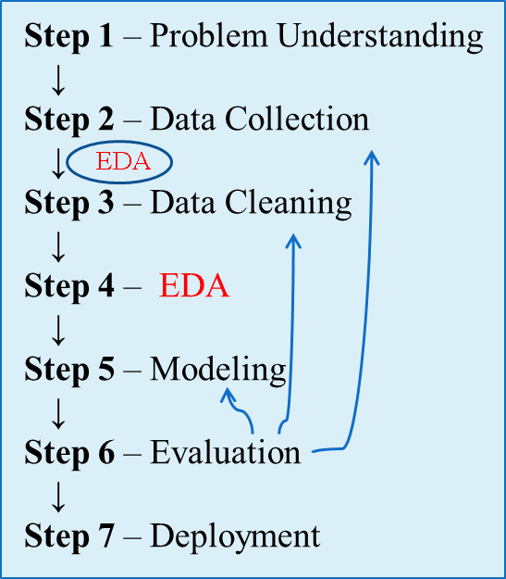
EDA: Visualization
1. Load Dataset
↓
2. Understand Structure
↓
3. Check Variable Types
↓
4. Compute Summary Statistics
↓
5. Identify Missing Values
↓
6. Detect Duplicates
↓
7. Detect Outliers
↓
8. Visualize Distributions
↓
9. Examine Relationships
↓
10. Generate Insights
↓
11. Prepare for Data Cleaning/Modeling

Slide 2
Data Visualization
Visualization is the process of projecting the data, or parts of it, into multi-dimensional space or abstract images. All the useful (and adorable) charts fall under this category.
Data visualization techniques are essential in data science for exploring, understanding, and communicating insights from data.
They translate complex data into visual stories, making it easier to identify trends, patterns, outliers, and correlations.
The purpose of visualization are:
For Showing Relationships and Correlation
For Comparing Values
For Showing Composition (Part-to-Whole)
For Understanding Distribution

Slide 3
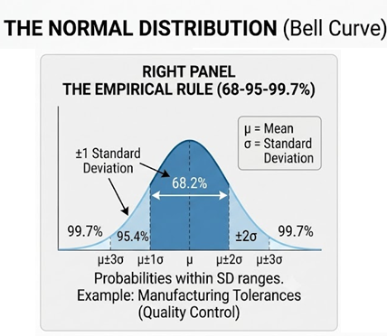
Data Visualization: Understanding Distributions
What is a Distribution?
Distribution skewness describes the asymmetry of a dataset's shape around its peak (mode). When a distribution is perfectly symmetrical (like a standard normal distribution), the left and right halves are mirror images.
However, real-world data often leans or stretches in one direction. This stretch is referred to as a positive or negative skew.

Slide 4
Data Visualization: Understanding Distributions
Positive Skewness (Right-Skewed Distribution)
A positively skewed distribution has a long tail that extends toward the right side (larger values). The mass of the data is concentrated on the left side of the graph, representing lower values.
Mathematical Relationship of Central Tendency: In a strongly positive skew, the metrics of central tendency split apart and always follow this predictable order: Mode < Median < Mean
Real-World Examples:
Household Income: The vast majority of citizens earn below or around the national average, clustering on the left. A tiny fraction of billionaires create a massive, elongated right tail.
Webpage View Counts: Most blog posts or videos get a few dozen hits, while a rare handful of viral posts pull the distribution infinitely to the right.

Slide 5
Data Visualization: Understanding Distributions
Negative Skewness (Left-Skewed Distribution)
A negatively skewed distribution is the exact opposite. It features a long, thin tail extending toward the left side (smaller or negative values), while the bulk of the data points cluster tightly on the right side.
Mathematical Relationship of Central Tendency: In a strongly negative skew, the directional pull reverses: Mean < Median < Mode
Real-World Examples:
Age of Retirement: Most individuals retire in their late 50s to late 60s, creating a steep cliff on the right side. However, a small minority of people forced to stop working early due to illness or other factors stretches the tail out to the left.
University Exam Scores (on an easy test): If an exam is straightforward, the vast majority of students will score high marks (As and Bs), clustering on the right. A few students who missed classes or ran out of time will score very low, creating a left-side tail.

Slide 6
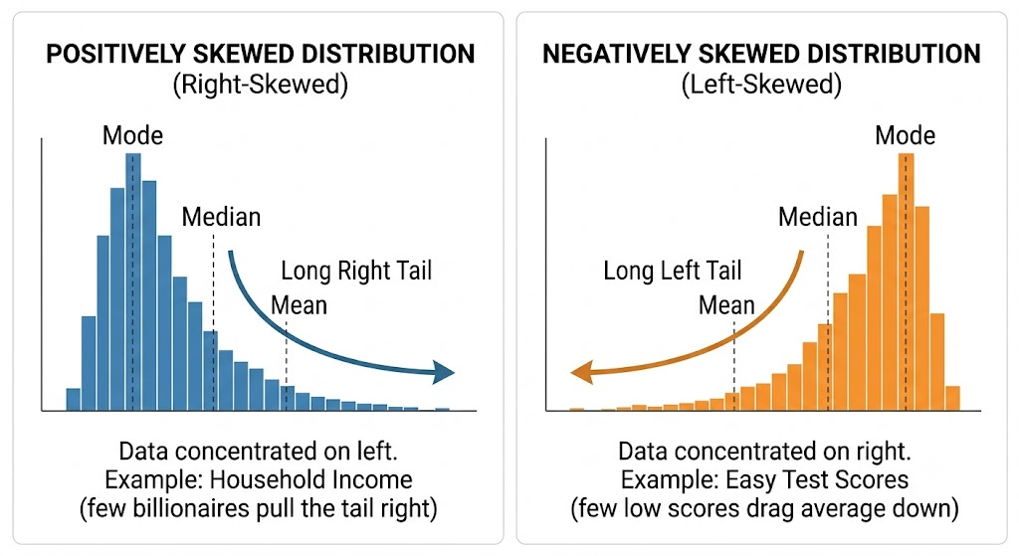
Data Visualization: Understanding Distributions

Slide 7
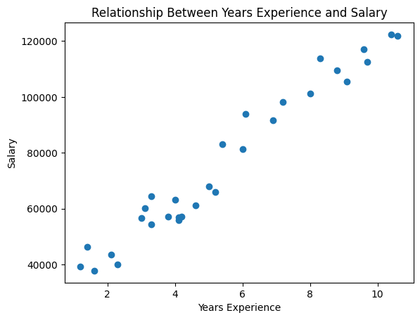
Data Visualization: Scatter Plot
A Scatter Plot is a fundamental two-dimensional data visualization tool used to analyze the relationship between two continuous numerical variables.
By plotting individual data points along a horizontal (X) and a vertical (Y) axis, it allows data scientists to visually inspect the data for patterns, trends, correlations, and anomalies.
The Core Components:
X-Axis (Horizontal): Typically represents the independent variable (predictor or explanatory variable).
Y-Axis (Vertical): Typically represents the dependent variable (outcome or response variable).
Data Points (Dots): Each marker on the graph represents a single observation in the dataset, uniquely positioned based on its coordinate pair (x, y).
https://medium.com/@wisnupo/simple-linear-regression-using-python-analysis-of-years-of-experience-on-salary-earned-192ce4bdf78c

Slide 8
Data Visualization: Scatter Plot
What Can a Scatter Plot Reveal?
Direction of Relationship
  Positive Correlation: Both variables increase together.
  Negative Correlation: One variable increases while the other decreases.
  No Correlation: No clear relationship between variables.
Strength of Relationship
  Strong: Data points are closely clustered around a trend.
  Weak: Data points are widely scattered.
Type of Relationship
  Linear: Relationship follows a straight-line pattern.
  Non-Linear: Relationship follows a curve or other pattern.
Anomalies and Hidden Patterns
  Outliers: Unusual observations far from the main data cluster.
  Clusters/Subgroups: Distinct groups of observations that may indicate different categories or behaviors.

Slide 9
Data Visualization: Bubble Chart
A Bubble Chart is an extension of the classic scatter plot. While a standard scatter plot compares two numerical variables on the X and Y axes, a bubble chart introduces a third (and sometimes fourth) variable by adjusting the size and color of the data points.
This allows to visualize three-dimensional or four-dimensional data on a flat, two-dimensional surface, making it an excellent tool for identifying complex relationships and clusters within your data.
A bubble chart maps variables to four specific visual attributes:
X-Axis (Horizontal): Represents the first continuous numerical variable (e.g., a country's GDP).
Y-Axis (Vertical): Represents the second continuous numerical variable (e.g., life expectancy).
Bubble Size (Area): Represents the third numerical variable (e.g., total population). Crucial Rule: The area of the bubble must be proportional to the value, not the radius or diameter, to prevent visually exaggerating the differences.
Bubble Color/Hue (Optional): Represents a fourth variable. This is often a categorical variable used to group the bubbles (e.g., Continent) or another continuous metric.

Slide 10
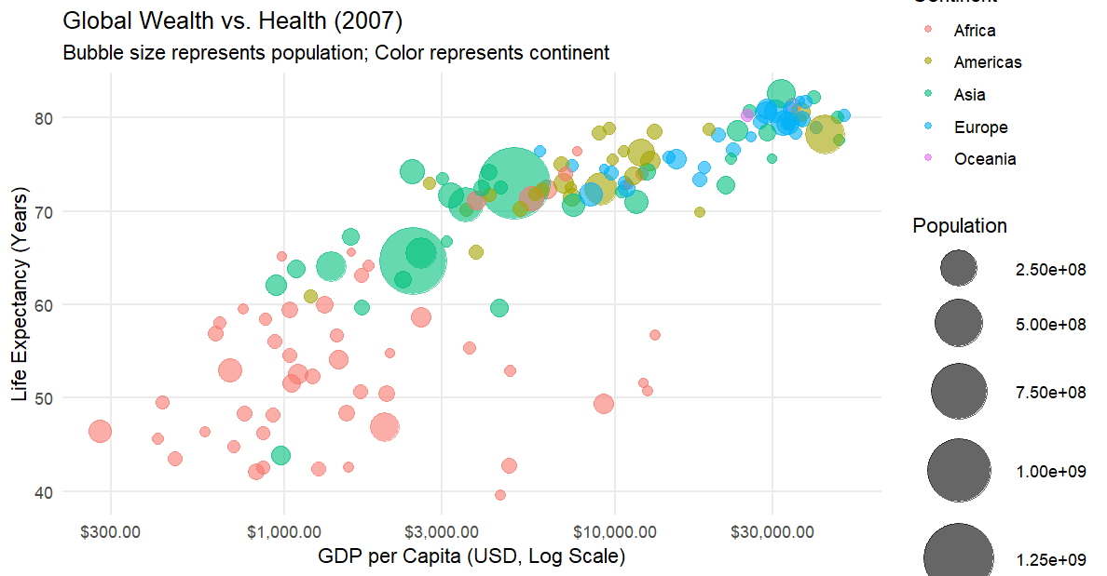
Data Visualization: Bubble Chart

Slide 11
Data Visualization: Heat Map
A Heatmap is a two-dimensional visual representation of data where individual values contained in a matrix are represented as colors.
In data science and statistics, heatmaps are primarily used to plot Correlation Matrices during Exploratory Data Analysis (EDA) or to visualize cross-tabulated frequencies between categorical variables.
The primary goal is to provide an immediate visual summary of dense numerical tables, leveraging human color perception to spot hot spots, cold spots, and trends at a glance.
The shading or saturation of a cell indicates the magnitude of its value. Usually, a clear color scale gradient (e.g., dark blue for low values to bright red for high values) is provided as a reference.

Slide 12
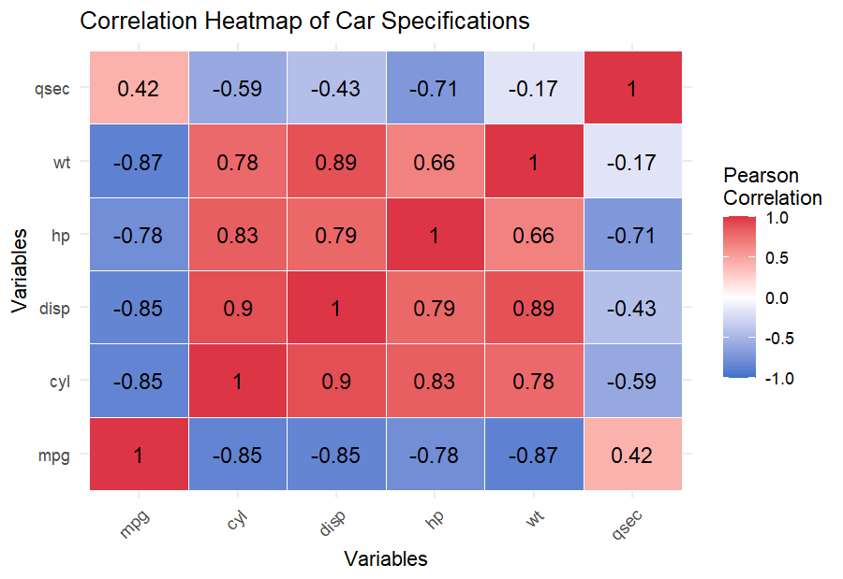
Data Visualization: Heat Map

Slide 13
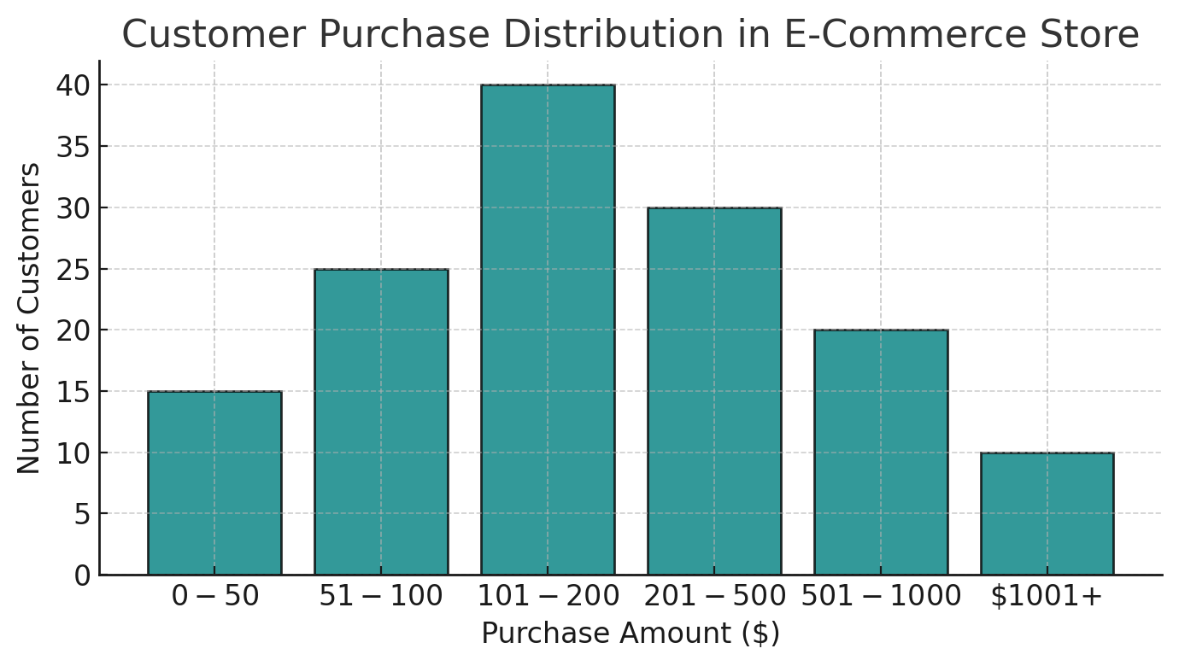
Data Visualization: Histogram
A Histogram is a fundamental data visualization tool used in statistics and data science to show the distribution of a continuous, numerical variable.
At first glance, a histogram looks very similar to a bar chart. However, while a bar chart compares discrete, categorical groups (like countries or products), a histogram takes a continuous range of numbers (like heights, weights, or exam scores) and splits them into consecutive, non-overlapping intervals called bins.
https://www.appliedaicourse.com/blog/historgam/
Core Components of a Histogram
The X-Axis (Continuous Scale): Represents the range of the numerical feature being analyzed. This axis is divided into equal-sized intervals (bins).
The Y-Axis (Frequency/Count): Represents the number of data points or observations that fall within each specific bin. Alternatively, it can display density or percentages.
The Bars: The height of each bar corresponds to the frequency of data points within that bin. Crucially, there are no gaps between the bars of a histogram. This lack of space visually signifies that the underlying data scale is continuous.

Slide 14
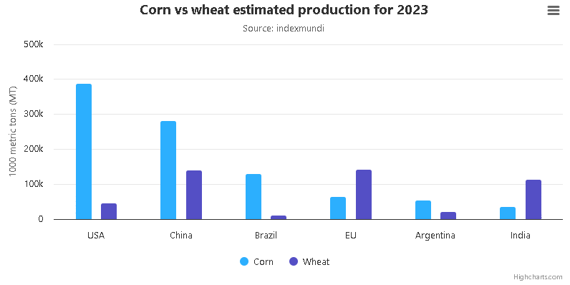
Data Visualization: Bar Chart
A Bar Chart (or bar graph) is one of the most widely used visual tools in data science and statistics. It represents categorical data using rectangular bars, where the length or height of each bar is proportional to the value it represents.
While a histogram is used to visualize the distribution of continuous numerical data, a bar chart is specifically designed to compare discrete quantities across different distinct groups or categories.
Core Components of a Bar Chart
Categorical Axis (Usually X-Axis): Displays the discrete groups, labels, or time periods being compared (e.g., countries, departments, fruit types).
Numerical Axis (Usually Y-Axis): Displays the metric value, such as frequencies, counts, percentages, or averages.
Bars: The individual rectangular elements. The widths of the bars should be uniform, and they should be separated by small gaps to emphasize that the categories are discrete, independent groups.

Slide 15
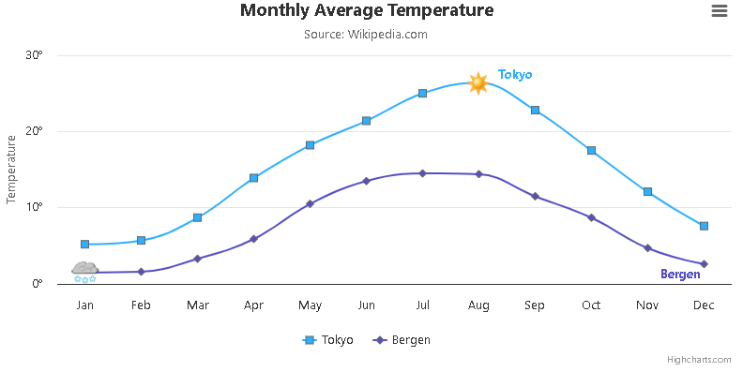
Data Visualization: Line Chart
Best for showing trends over a continuous interval, most often time. It connects a series of data points with a line.
What Does a Line Chart Reveal?
Trends Over Time
  Increasing trend
  Decreasing trend
  Stable trend
Rate of Change
  Rapid growth or decline
  Gradual changes
Patterns
  Seasonal patterns
  Cyclical fluctuations
  Repeated behaviors
Peaks and Troughs
  Highest and lowest values
  Significant events or anomalies
Comparisons
  Multiple lines can compare trends across groups or categories

Slide 16
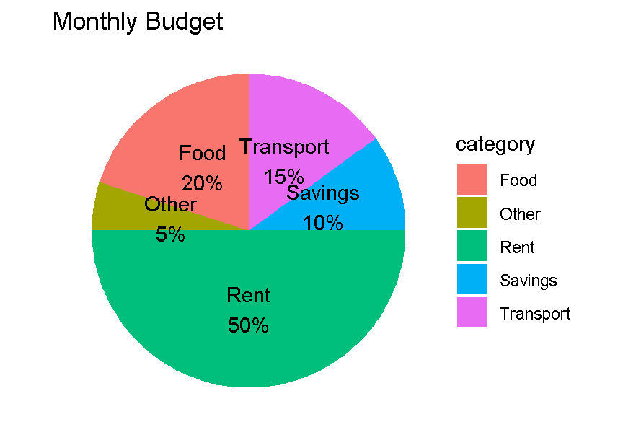
Data Visualization: Pie Chart
A circular chart that shows the percentage contribution of different categories to a whole. It's best used for a small number of categories.
What Does a Pie Chart Reveal?
Part-to-Whole Relationship
  Shows how much each category contributes to the total.
Relative Proportions
  Easily identifies the largest and smallest categories.
Percentage Distribution
  Displays the share of each category as a percentage of the whole.
Category Comparison
  Useful when there are only a few categories (typically 3–6).

Slide 17
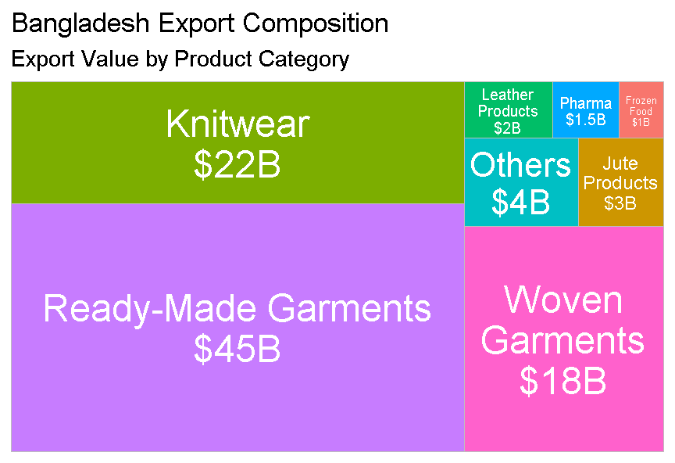
Data Visualization: Tree Map
A treemap is an alternative to pie charts for showing parts of a whole, using nested rectangles. Each category is a rectangle whose area is proportional to its value.
Treemaps handle many categories and hierarchical data much better than pie charts.
Treemaps are useful for visualizing part-to-whole relationships when there are many categories or hierarchical structures. The area of each rectangle is proportional to the value it represents.

Slide 18
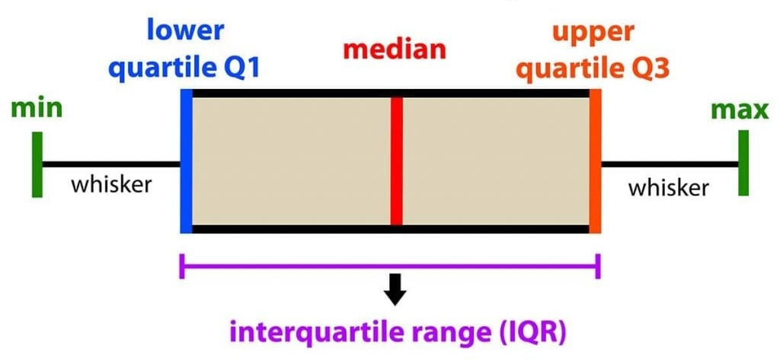
Data Visualization: Box Plot
A Box Plot (also known as a box-and-whisker plot) is a standardized visual tool used in Exploratory Data Analysis (EDA) to display the distribution of a continuous numerical dataset based on a five-number summary.
https://www.simplypsychology.org/boxplots.html

Slide 19
Data Visualization: Box Plot: For Understanding Distribution
A box plot breaks down a dataset into quartiles (quarters), where each major component represents a specific statistical boundary:
The Median (Q2/ 50th Percentile): The line that cuts through the center of the box. Half of the data points fall below this line, and half fall above it.
The Box (Interquartile Range / IQR): The main body of the plot represents the middle 50% of the data.
  Lower Quartile (Q1 / 25th Percentile): The bottom/left edge of the box. 25% of the data falls below this point.
  Upper Quartile (Q3 / 75th Percentile): The top/right edge of the box. 75% of the data falls below this point.
  IQR = Q3 - Q1
The Whiskers: The lines extending outside the box. They represent the data points that fall within a "normal" expected range. They extend out to the minimum and maximum data points that are not outliers.
Outliers: Individual data points plotted as isolated dots or asterisks beyond the ends of the whiskers.

Slide 20
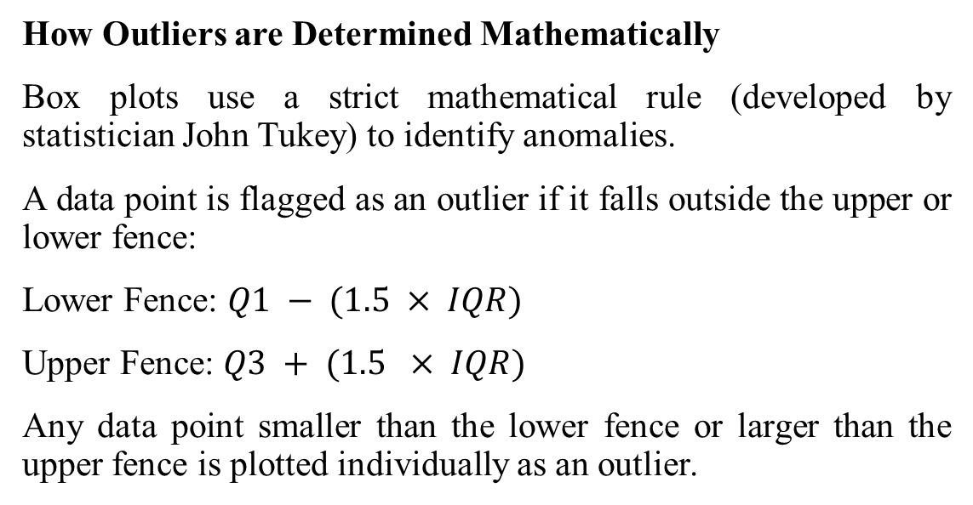
Data Visualization: Box Plot: For Understanding Distribution
How Outliers are Determined Mathematically
Box plots use a strict mathematical rule (developed by statistician John Tukey) to identify anomalies.
A data point is flagged as an outlier if it falls outside the upper or lower fence:
Lower Fence: $Q1 − (1.5 × IQR)$
Upper Fence: $Q3 + (1.5 × IQR)$
Any data point smaller than the lower fence or larger than the upper fence is plotted individually as an outlier.

Slide 21
Data Visualization: Box Plot: For Understanding Distribution
What a Box Plot Tells You at a Glance
1. Variability and Spread: A long box means the data is highly spread out and has high variance. A short box means the middle 50% of the data points are highly clustered together (low variance)
2. Identifying Skewness: By looking at the position of the median line inside the box, you can determine the distribution's shape without looking at a histogram:
Visual Indicator | Statistical Meaning
Median is perfectly in the center | The distribution is symmetrical (e.g., normal distribution).
Median is closer to Q1 | The data is positively skewed (right-skewed). A few high values are pulling the tail.
Median is closer to Q3 | The data is negatively skewed (left-skewed). A few low values are pulling the tail.

